Slide 1
PART II DIGITAL ELECTRONICS
Chapter 4 : Number systems and Codes
Reference
Malvino and Leach, Digital Principles & applications, 7th edition, TMH, 2010
Morris Mano, “Digital Design”, Prentice Hall of India, Third Edition.

Slide 2
Module 1 : Number systems
Learning outcomes
At the end of this module, students will be able to:
Describe the decimal, binary, hexadecimal and octal system.
Convert the number in binary, octal or hexadecimal to a number in the decimal system and vise versa.
Describe the binary arithmetic using ones and two’s complement

Slide 3
Introduction
Why Number System
Importance of Number system in electronics

Slide 4
Number System
The different number systems are:
Decimal system
Binary system
Hexadecimal system
Octal system

Slide 5
Decimal System
10 symbols, namely 0,1,2,3,4,5,6,7,8 and 9.
Example: (781)₁₀, (6543.124)₁₀
6543.124
Digit | 6 | 5 | 4 | 3 | . | 1 | 2 | 4
Weight | 10³ | 10² | 10¹ | 10⁰ | Decimal Point | 10⁻¹ | 10⁻² | 10⁻³

Slide 6
Binary System
Uses only two symbols ‘0’and’1’ .
Radix-2 system. Example: (100010)₂, (1011.101)₂.
1011.101
Digit | 1 | 0 | 1 | 1 | . | 1 | 0 | 1
Weight | 2³ | 2² | 2¹ | 2⁰ | Binary Point | 2⁻¹ | 2⁻² | 2⁻³

Slide 7
Hexadecimal System
The hexadecimal number system has base 16.
It has 16 distinct symbols. It uses the digits 0-9 and letters A,B,C,D, E and F as 16 symbols.
Example:
4A90.2BC
Digit | 4 | A | 9 | 0 | . | 2 | B | C
Weight | 16³ | 16² | 16¹ | 16⁰ | Hexadecimal Point | 16⁻¹ | 16⁻² | 16⁻³

Slide 8
Octal System
Uses 8 symbols (0-7)
Example: (723)₈, (2157.075)₈.
Digit | 2 | 1 | 5 | 7 | . | 0 | 7 | 5
Weight | 8³ | 8² | 8¹ | 8⁰ | Octal Point | 8⁻¹ | 8⁻² | 8⁻³

Slide 9
Self Test
The hex numbering system has a base of ________, and the binary numbering system has a base of ________.
The value of a particular digit in a number is determined by its relative position in a sequence of digits. (T/F)
A single hexadecimal digit can represent how many binary digits: (a) two, (b) three, or (c) four?
The bases of the binary and decimal numbering systems are multiples of 2. (T/F)

Slide 10
Conversion of Number System
Decimal
Decimal to Binary
Decimal to Octal
Decimal to Hexadecimal
Binary
Binary to Octal
Binary to decimal
Binary to Hexadecimal
Octal
Octal to binary
Octal to decimal
Octal to Hexadecimal
Hexadecimal
Hexadecimal to Binary
Hexadecimal to Octal
Hexadecimal to decimal

Slide 11
Conversion
Decimal System

Slide 12
Decimal to Binary
Real Part:
The given decimal number is repeatedly divided by 2.
Till quotient becomes ‘0’ .
Remainder is collected from bottom to top.
Fractional Part:
Fractional part is multiplied by two repeatedly.
The integer part is recorded.
The string of integer obtained from the top to bottom gives the equivalent fractional number in binary

Slide 13
Decimal to Binary
Q1. (37)₁₀ = (100101)₂
37 | divided by | 2 | Q=18 | R=1
18 | divided by | 2 | Q=9 | R=0
9 | divided by | 2 | Q=4 | R=1
4 | divided by | 2 | Q=2 | R=0
2 | divided by | 2 | Q=1 | R=0

Slide 14
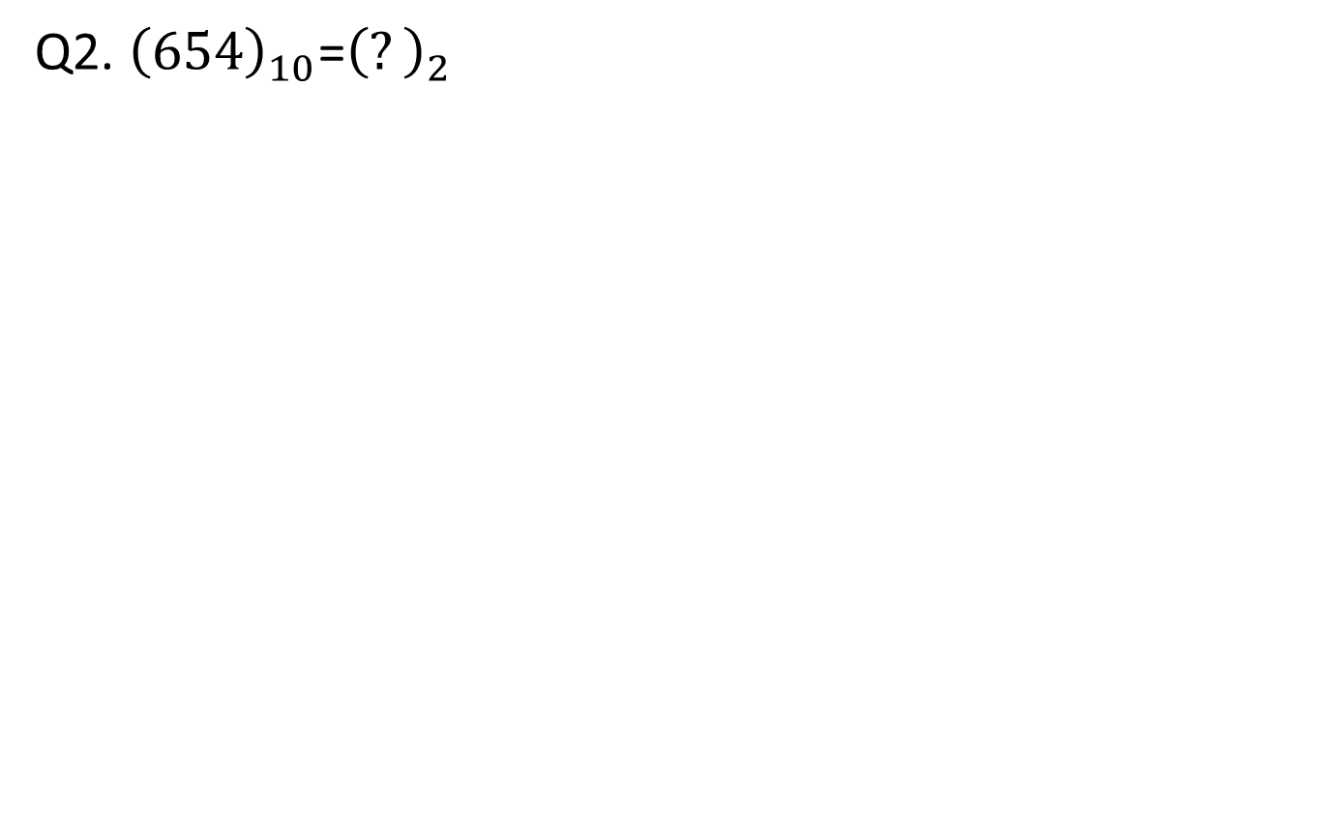
Q2. ${\left(654\right)}_{10}$=${\left(?\right)}_{2}$

Slide 15
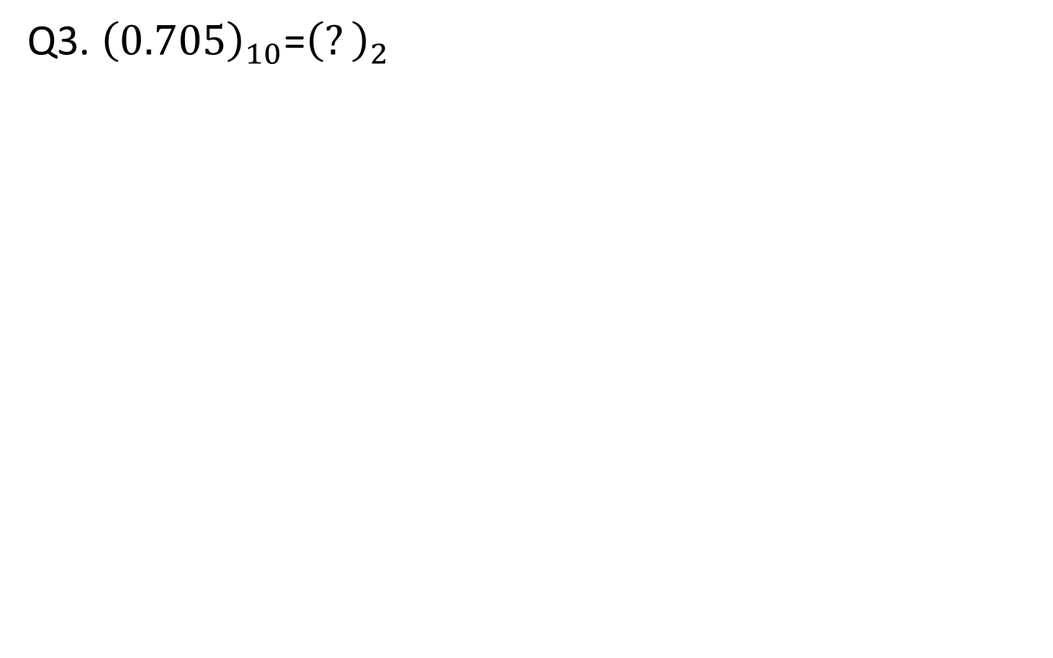
Q3. ${\left(0.705\right)}_{10}$=${\left(?\right)}_{2}$

Slide 16
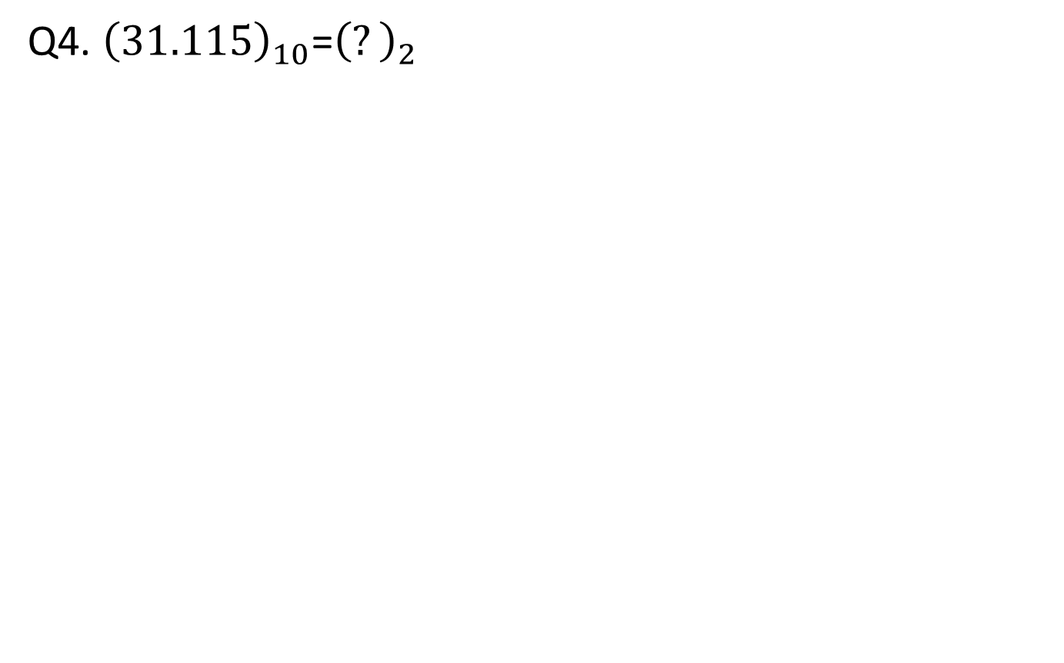
Q4. ${\left(31.115\right)}_{10}$=${\left(?\right)}_{2}$

Slide 17
Decimal to Octal
Real Part:
The given decimal number is repeatedly divided by 8.
Till quotient becomes ‘0’ .
Remainder is collected from bottom to top
Fractional Part:
Fractional part is multiplied by eight repeatedly.
Carry in the integer place is recorded.
The string of integer obtained fro m the top to bottom gives the equivalent fractional number in octal

Slide 18
Decimal to Octal
Ex: (97)₁₀ = (141)₈
37 | divided by | 8 | Q=12 | R=1
12 | divided by | 8 | Q=1 | R=4

Slide 19
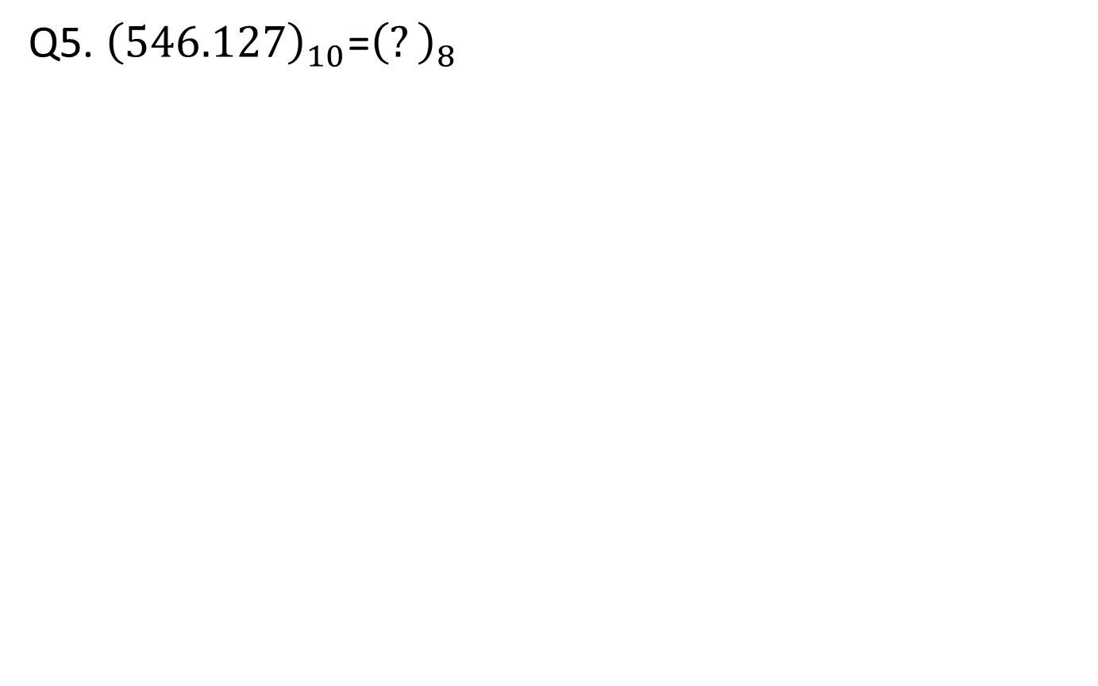
Q5. ${\left(546.127\right)}_{10}$=${\left(?\right)}_{8}$

Slide 20
Decimal to Hexadecimal
Real Part:
The given decimal number is repeatedly divided by 16.
Till quotient becomes ‘0’ .
Remainder is collected from bottom to top
Fractional Part:
Fractional part is multiplied by sixteen repeatedly.
Carry in the integer place is recorded.
The string of integer obtained fro m the top to bottom gives the equivalent fractional number in hexadecimal.

Slide 21
Decimal to Hexadecimal
Ex: (546)₁₀ =(222)₁₆
546 | divided by | 16 | Q=34 | R=2
34 | divided by | 16 | Q=2 | R=2

Slide 22
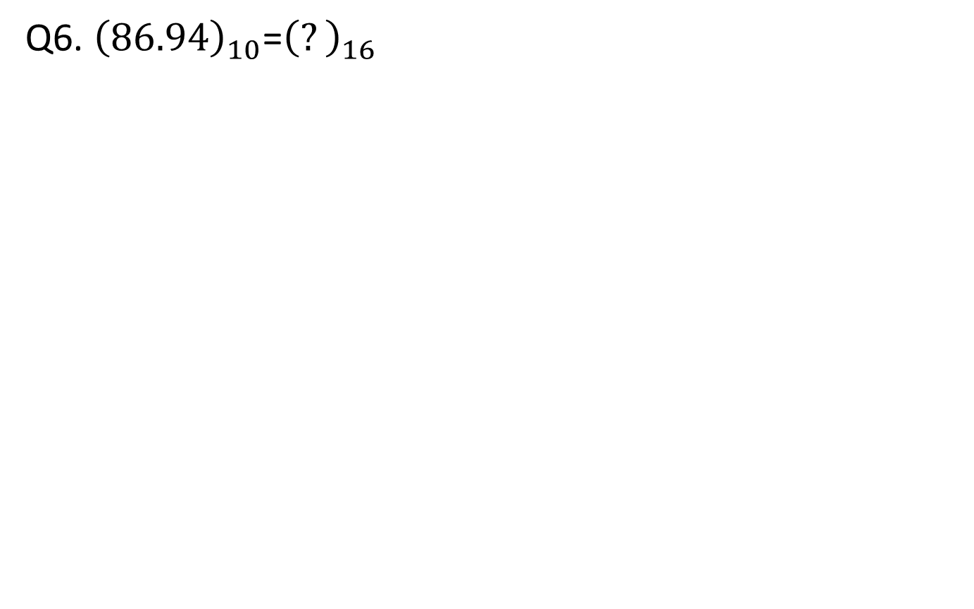
Q6. ${\left(86.94\right)}_{10}$=${\left(?\right)}_{16}$

Slide 23
Conversion
Binary System

Slide 24
Binary to Octal
Each octal digit is represented by three bits of binary digits.
Ex1: (110101010)₂ =
110 101 010 =
6 5 2 = (652)₈
Ex2: (0.1011010)₂ =
101 101 0
5 5 0 = (0. 550)₈
Ex3: (110101010. 1011010)₂ = (652.550)₈

Slide 25
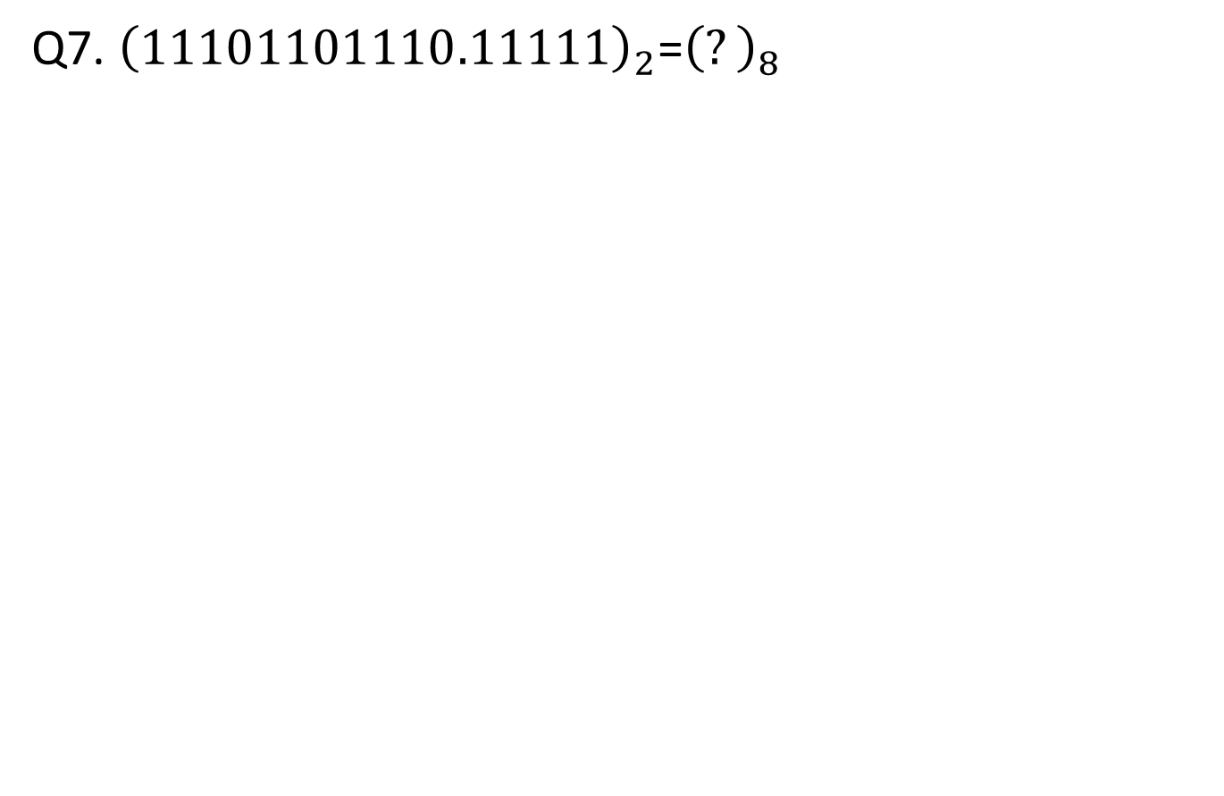
Q7. ${\left(11101101110.11111\right)}_{2}$=${\left(?\right)}_{8}$

Slide 26
Binary to Decimal
Multiply the number by its equivalent binary weights.
Add the products to get the decimal number.
Ex1: 110₂ = 1 x 2² + 1 x 2¹ + 0 x 2⁰ = 4 +2+0 = 6
Ex2: 0.101₂ = 1 x 2⁻¹ + 0 x 2 ⁻² + 1 x 2⁻³ = 0.5 + 0 + 0.125 = 0.625

Slide 27
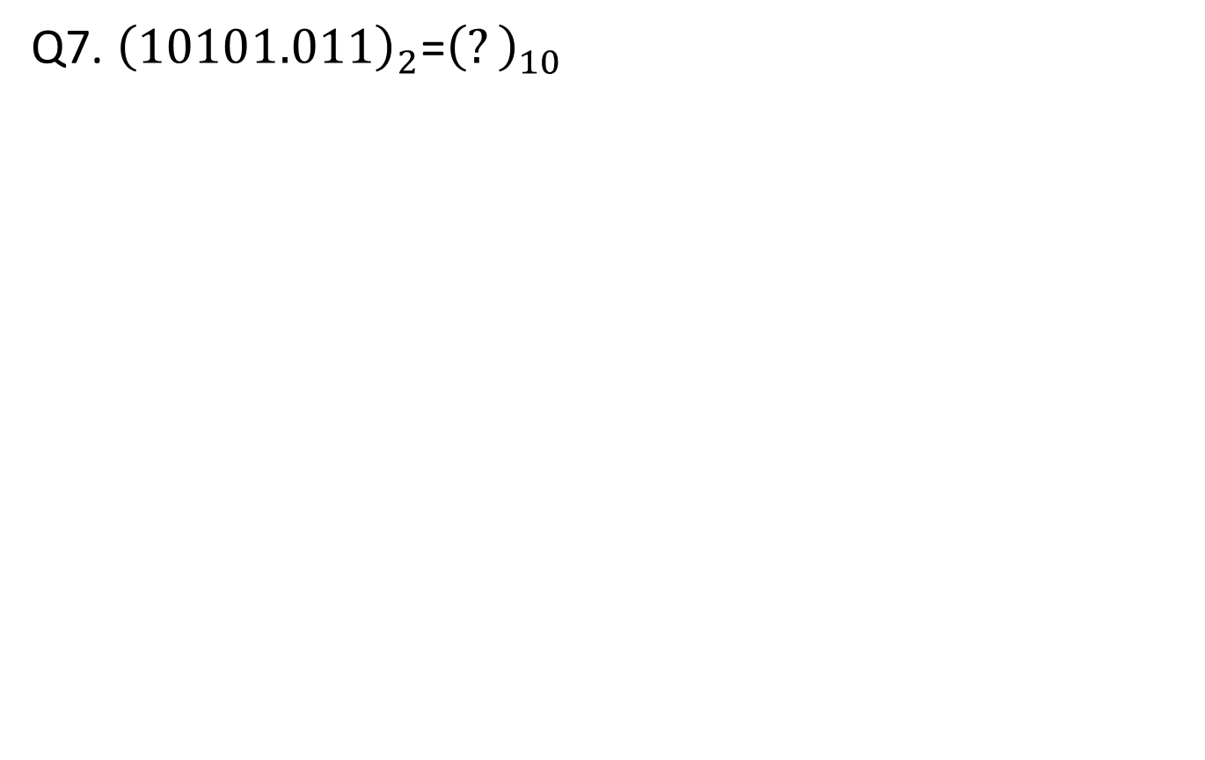
Q7. ${\left(10101.011\right)}_{2}$=${\left(?\right)}_{10}$

Slide 28
Binary to Hexadecimal
Each group of 4 binary bits is 1 hexadecimal digit.
Ex1: (111110110010)₂ =
1111 1011 0010
15 11 2
F B 2
(FB2)₁₆
Ex2: (0.010101111011)₂
0101 0111 1011
5 7 11
5 7 B
(0.57B) ₁₆

Slide 29
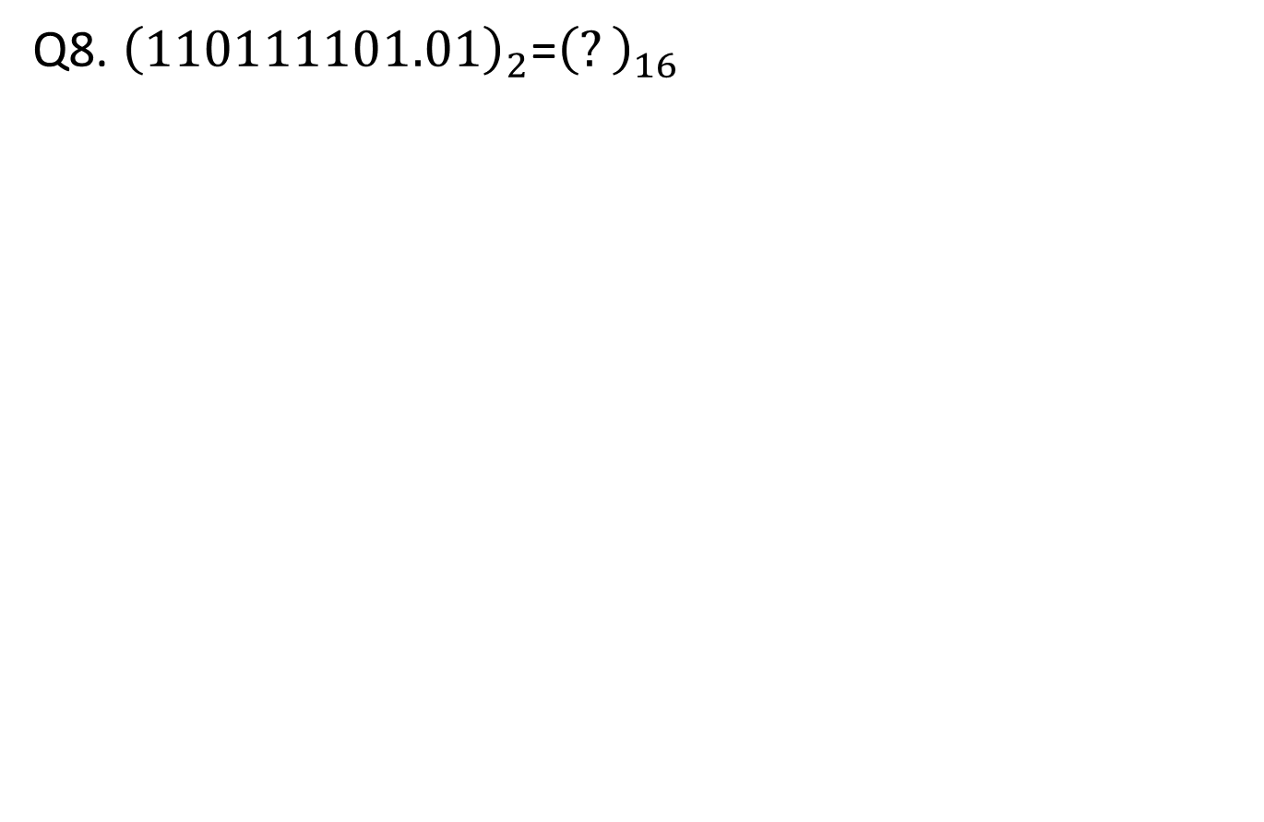
Q8. ${\left(110111101.01\right)}_{2}$=${\left(?\right)}_{16}$

Slide 30
Conversion
Octal System

Slide 31
Octal to Binary
Each octal digit is represented by three bits of binary digit.
Ex1: (347)₈ = (011100111)₂
Ex2: (0.245)₈ = (0.010100101)₂
Ex3: 347.245₈ = (011100111.010100101)₂

Slide 32
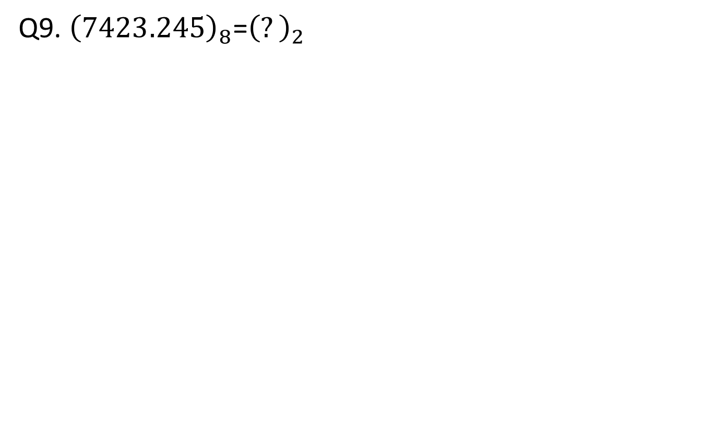
Q9. ${\left(7423.245\right)}_{8}$=${\left(?\right)}_{2}$

Slide 33
Octal to Decimal
Multiply the number by its equivalent octal weights.
Add the products to get the decimal number.
Ex1: (457)₈ = 4 x 8² + 5 x 8¹ + 7 x 8⁰ = 4 x 64 + 5 x 8 + 7 x 1 = 256+40+7 = (303)₁₀
Ex2: (0.246)₈ = 2 x 8⁻¹ + 4 x 8⁻² + 6 x 8⁻³= 2 x 0.125 + 4 x 0.015625 + 6 x 0.001953125
= (0.267969)₁₀

Slide 34
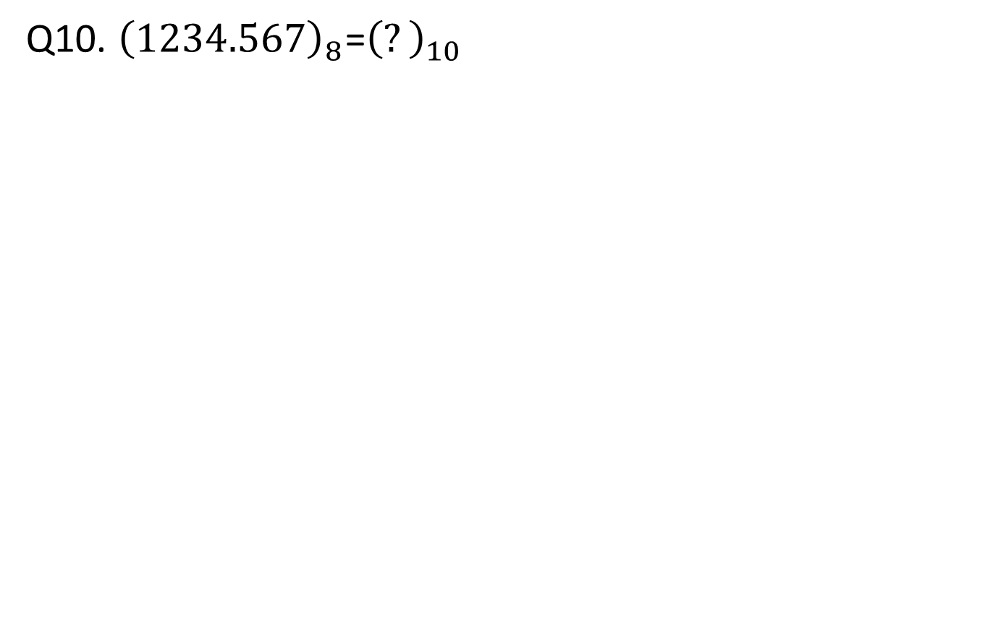
Q10. ${\left(1234.567\right)}_{8}$=${\left(?\right)}_{10}$

Slide 35
Octal to Hexadecimal
The octal number is first converted into binary.
The binary bits are grouped such that each group consists of 4 bits and a group starts from the LSB.
The 4 bits group is represented by its equivalent hexadecimal number.
Ex1: (235)₈ = (09D)₁₆
(235)₈ = (0 1001 1101)₂ = (09D)₁₆

Slide 36
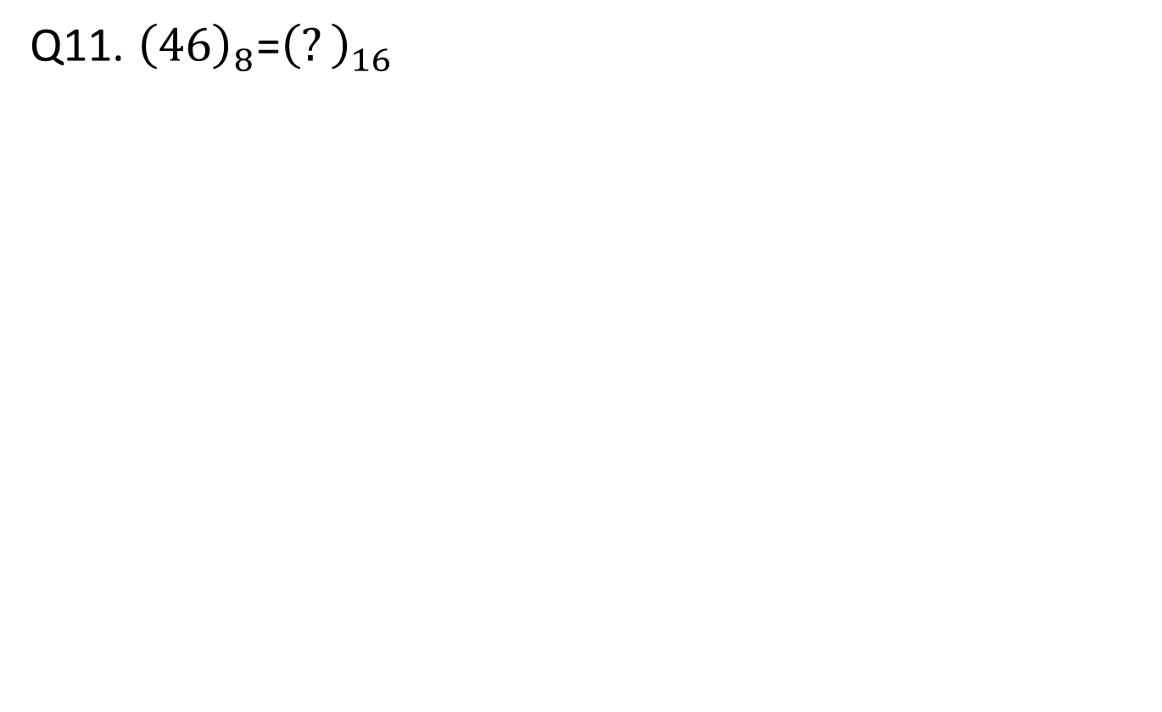
Q11. ${\left(46\right)}_{8}$=${\left(?\right)}_{16}$

Slide 37
Conversion
Hexadecimal System

Slide 38
Hexadecimal to Binary
Each group of 4 binary bits is 1 hexadecimal digit.
Ex1: (A7D)₁₆ = (1010 0111 1101)₂

Slide 39
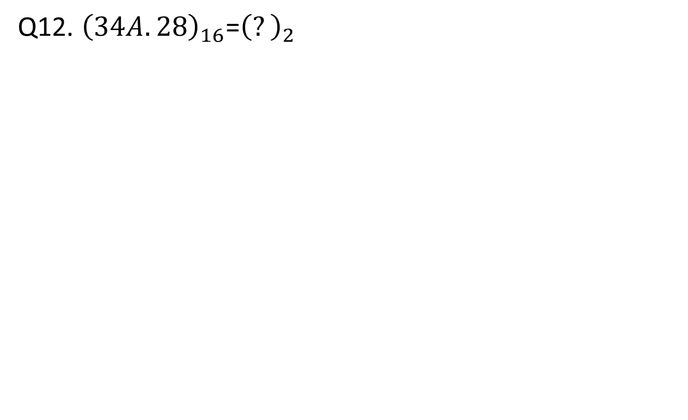
Q12. ${\left(34A.28\right)}_{16}$=${\left(?\right)}_{2}$

Slide 40
Hexadecimal to Octal
The hexadecimal number is first converted into binary.
They are grouped into 3 bits each starting from the LSB.
The 3 bits group is represented by its equivalent octal number.
Ex1: (C4)₁₆ = (11 000 100)₂= (304)₈
Ex2: (0.26A)₁₆ = (0.001 001 101 010)₂ =(0.1152)₈
Ex3: (C4.26A)₁₆ = (11 000 100.001 001 101 010)₂ = (304.1152)₈

Slide 41
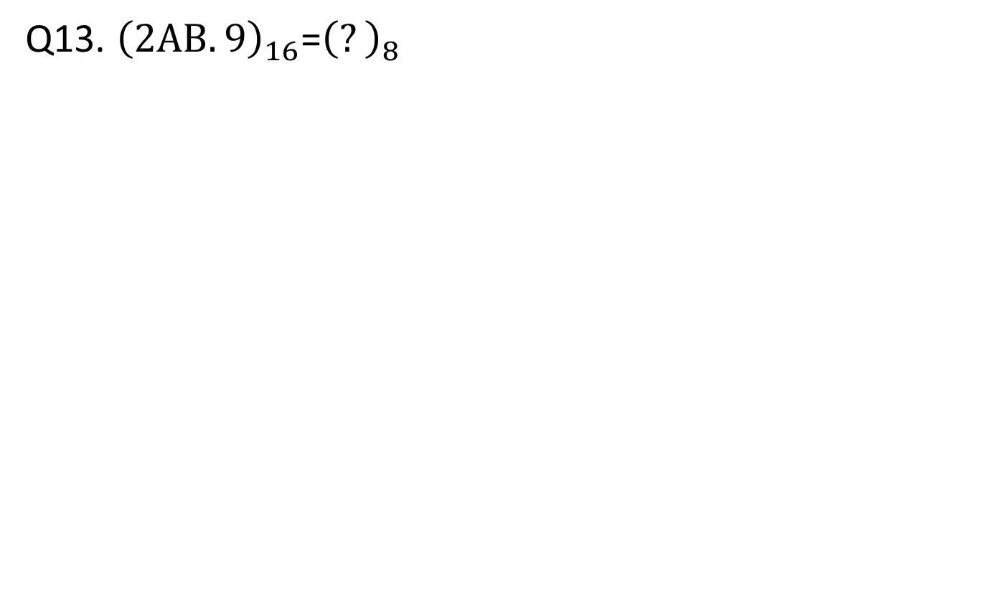
Q13. ${\left(2AB.9\right)}_{16}$=${\left(?\right)}_{8}$

Slide 42
Hexadecimal to Decimal
Multiply the number by its equivalent hexadecimal weights.
Add the products to get the decimal number.
Ex1: (B40)₁₆ = 11 x 16² + 4 x 16¹ + 0 x 16⁰
= 11 x 256 + 4 x 16 + 0 x 1
=(2880)₁₀
Ex2: (0.237)₁₆ = 2 x 16⁻¹ + 3 x 16⁻² + 7 x 16⁻³
= (0.138427)₁₀

Slide 43
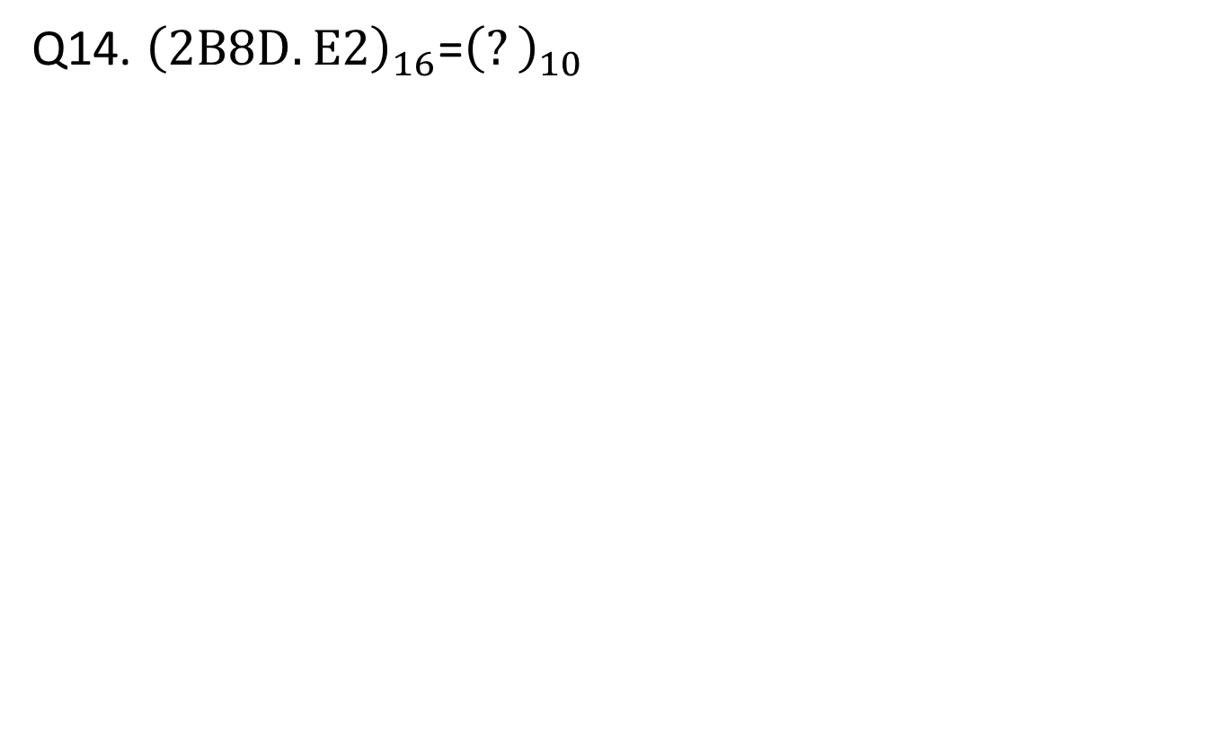
Q14. ${\left(2B8D.E2\right)}_{16}$=${\left(?\right)}_{10}$

Slide 44
Number System Arithmetic
Binary Addition
Ex1: (1010)₂ + (0111)₂ = (10001)₂
(1010)₂ = (10)₁₀
+(0111)₂ = (7)₁₀
(10001)₂ = (17)₁₀

Slide 46
Number System Arithmetic
Octal
Ex1: Add ( 334.65)₈ to (671.14) ₈ = 1226.01₈

Slide 48
Number System Arithmetic
Hexadecimal
Add (7AB.67)₁₆ to (15C.71) ₁₆ = (907. D8)₁₆

Slide 50
1’s and 2’s Complement
To find 1’s complement of a binary number just invert the bits.
To find 2’s complement of a binary number find 1’s complement and add 1 to the result.
1’s complement of 0011 is 1100.
2’s complement of 0110 is 1010.

Slide 51
Subtraction using 1’s complement method
1)Add minuend to the 1’s complement of subtrahend
2)Check the result obtained in step 1 for any carry
a)If an end carry occurs, add it to the LSB
b)If an end carry doesn’t occur, get the 1’s complement of the answer obtained in step 1 and place a negative sign before it.

Slide 52
Subtraction using 2’s complement method
1)Add minuend to the 2’s complement of subtrahend
2)Check the result obtained in step 1 for any carry
a)If an end carry occurs, discard it
b)If an end carry doesn’t occur, get the 2’s complement of the answer obtained in step 1 and place a negative sign before it.

Slide 53
Ex1: Subtract (0011)2 from (0101)2 using 1’s complement.
Step1: 0101 is minuend and 0011 is subtrahend.
Step2: 1’s complement of 0011 is 1100.
Step3: 0101 + 1100 = 1 0001(there is a carry)
Step4: 0001 + 1 = 0010 (5 – 3 =2)

Slide 54
Summary
List different number system in use of processing
Binary, decimal, octal and hexadecimal are commonly used number systems
Convert number in one system to another system.
Perform basic arithmetic’s using various number system

Slide 55
Exercise
Subtract 14 from 46 using the 2’s complement method.
Subtract 35 from 23 using 2’s complement.

Slide 62
Self Test
The binary equivalent of a hexadecimal 35 is ________.
The decimal equivalent of a hexadecimal 7 is ________.
The hexadecimal equivalent of a decimal 49 is ________.
The decimal equivalent of a binary 110110110 is ________.
The hexadecimal equivalent of a binary 1110 is ________.
The result of 101₂ + 11₂ is ________ (in binary).
The result of A1₁₆ + BC₁₆ + 10₁₆ is ________ (in hexadecimal).

